Slide 1


POKÉMON GO DATA ANALYSIS
PROJECT
Presented by: Team 7
C. Randriamampionona
G. Nube
C. Gkoritsas
V. Bera
M. Beyai
D. Acharya
Date: 21/2/2025
Course: Data-Driven Insights

Slide 2
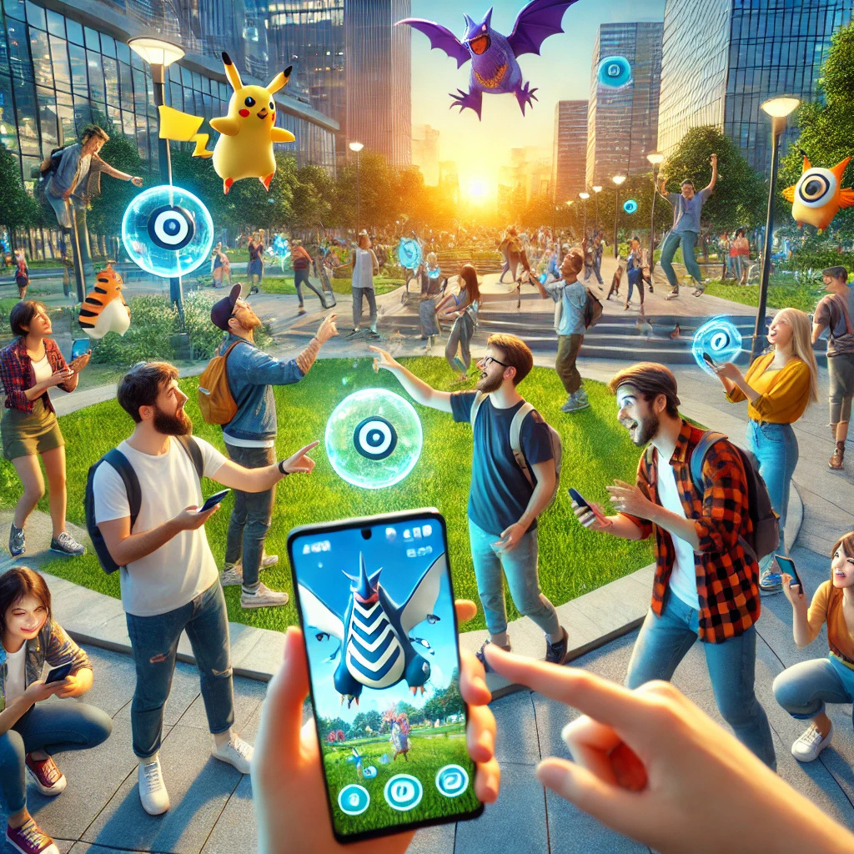


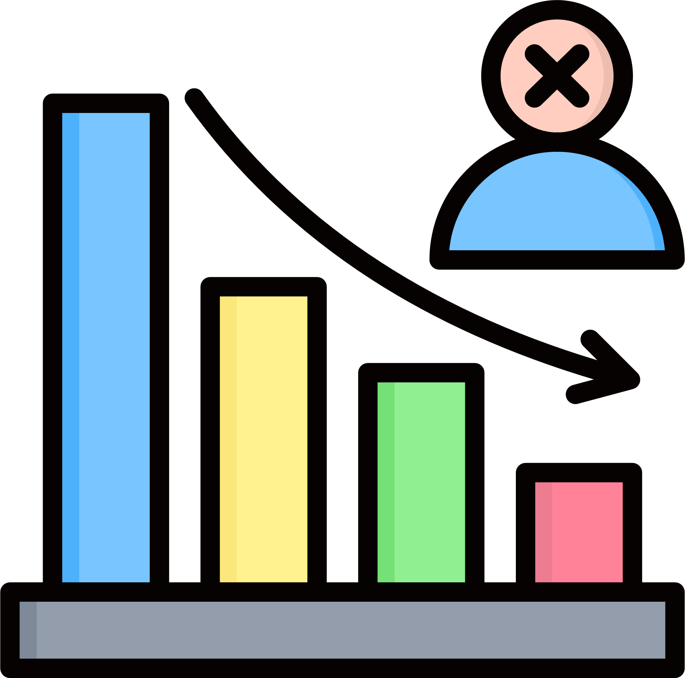
Objectives
Customer Personas: Who are the main customer groups? (e.g., frequent buyers, occasional users, and inactive customers)
Customer Profiling: What are their demographics and behaviors? (e.g., age, income level, spending patterns)
Churn Prediction: Why do customers stop using the product? (e.g., lack of engagement, high prices, better alternatives)

Slide 3




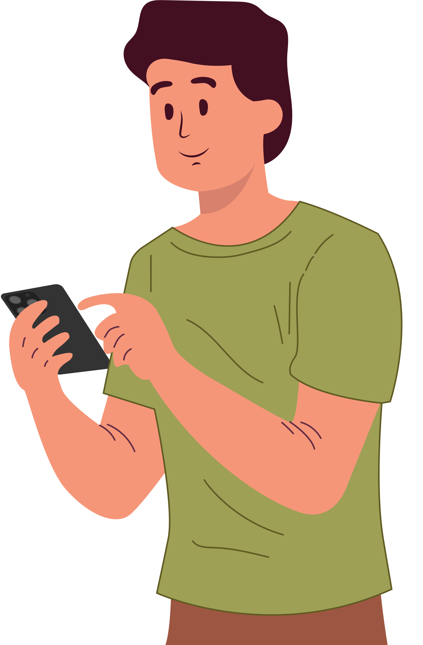
Player Profile
Summary
Plays
7 times per summer
Spends
€3.99 (on average)
Enjoys social aspects of the game
28 years old, low-income male

Slide 4
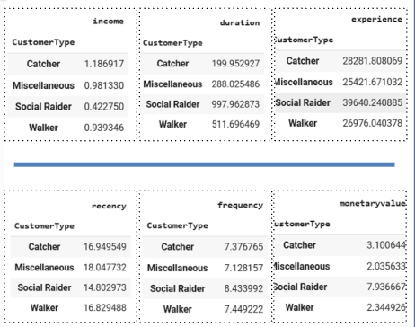
Understanding Customer Engagement
Key Insights:
Catcher: Demonstrates moderate engagement with balanced gameplay metrics.
Miscellaneous: Exhibits low visit frequency and minimal spending, reflecting infrequent gameplay.
Social Raider: Generates the highest spending and accumulates the most experience points.
Walker: Engages with the longest play duration and most frequent sessions, showcasing consistent activity.

Slide 5




RFM Metrics Overview
Metric | Metric | Average Value
Recency (Days Since Last Play) |  | 5 Days
Frequency (Sessions Per Player) |  | 7.63 Sessions
Monetary Value (€ Spent) |  | €3.99

Slide 6
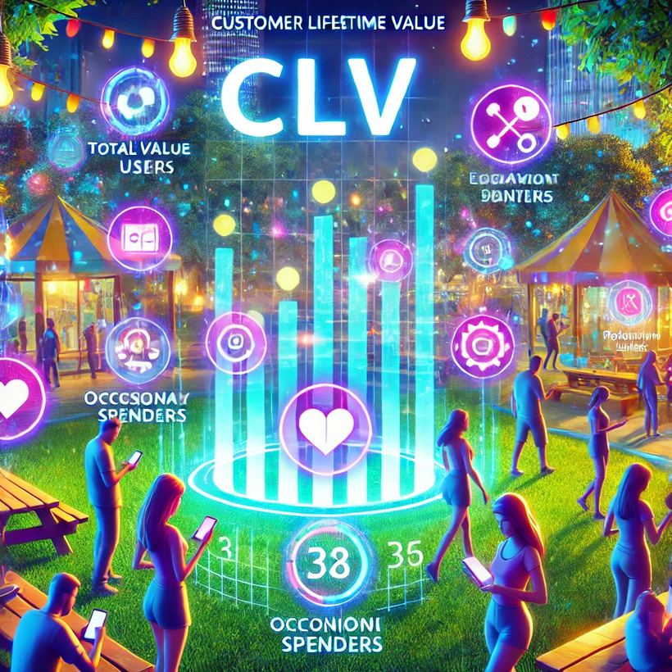



Customer Lifetime Value
(CLV) Calculation
Metrics Used:
Calculated CLV using monetary value, WACC (Weighted Average Cost of Capital), retention rates, and 3 periods.
Initial calculation applied a blanket 90% retention rate based on a comparison of summer and fall playerbases.
Follow-up calculation used individual retention rates derived from player churn analysis.
Industry Standard WACCs: EA Inc: 8.5%, VNintendo: 7.8%, Tencent: 8.3%
Results:
€568,058.87 – Using the 90% blanket retention rate
€402,526.11 – Using individual retention rates

Slide 7
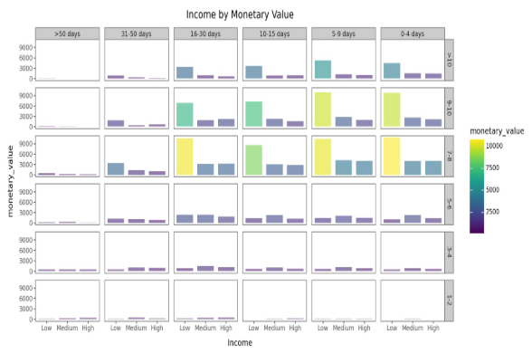
Lifecycle Grid
Definition: Lifecycle grids help analyze player behavior based on recency, frequency, and spending patterns.
Goal: Identify which player segments contribute the most to Pokémon Go’s revenue and how Niantic can improve engagement.
Data Used
Summer play session data
Summer financial transactions
Player data

Slide 8
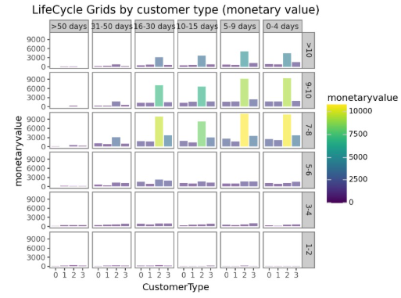
Lifecycle Grid by Customer Type (Monetary Value)
Key Insights:
Social Raiders (Customer Type 2) generate the most revenue.
Players who engaged in the last 5-15 days have higher monetary value.
Retention Strategy: Create exclusive rewards and events for Social Raiders to increase spending.
Key Data Points:
Groups 1, 3, and 4 have lower spending levels.
Revenue peaks at the 5-15 day recency range.

Slide 9
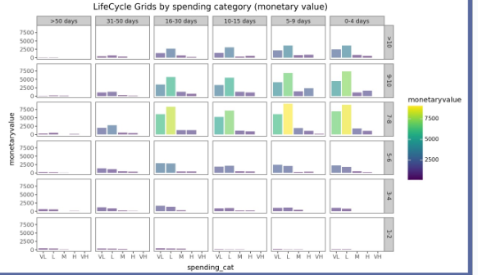
Lifecycle Grid by Spending Category (Monetary Value)
Key Insights:
Most revenue comes from frequent, small purchases, not large one-time payments.
Players within 5-15 days of activity tend to spend the most.
Marketing Focus: Encourage low-tier buyers to make repeat purchases by offering bundles, discounts, or time-sensitive promotions.
Key Data Points:
VL (Very Low) and L (Low) spending categories dominate.
Players with high spending habits (H, VH) are fewer but still relevant.

Slide 10
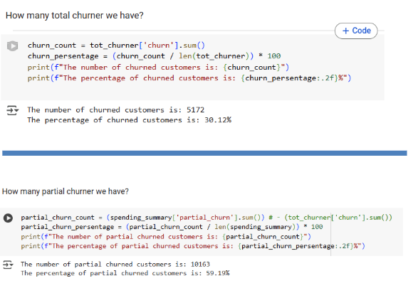
Churn Analysis
Churn Rate Calculation – We measured how many customers stopped or reduced spending.
Complete Churners – Some customers bought in the summer but stopped completely in the fall.
Partial Churners – Some customers continued buying but spent much less in the fall.

Slide 11
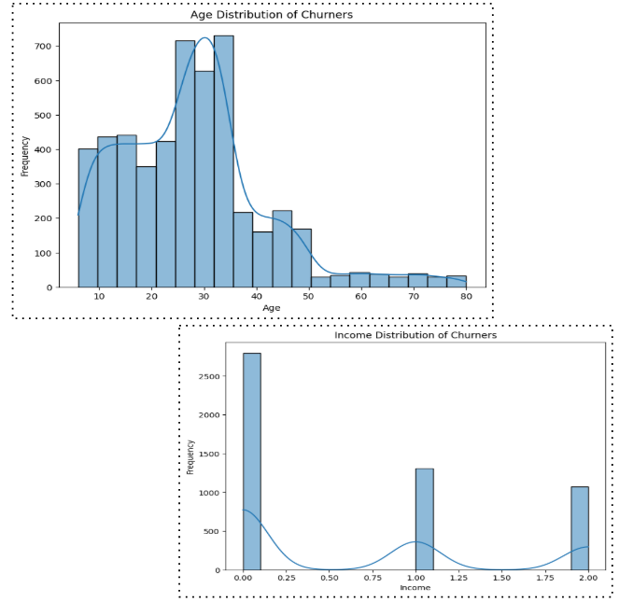
Demographic Impact on Churn
Key Insights:
younger customers or those with lower incomes might be more likely to leave..

Slide 12
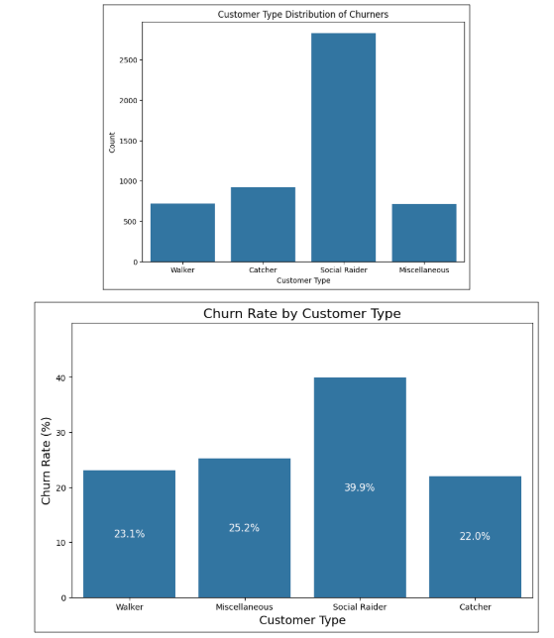
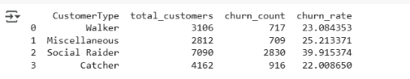
Customer Type and Churn Patterns
Different customer types exhibit varying churn patterns.
Understanding these patterns is crucial for developing target retention strategies

Slide 13
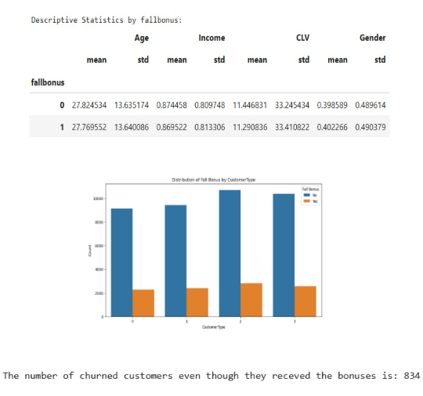


Fall Bonus Analysis
Fall Bonus was distributed randomly but equally across all customer types segments
834 players churned even after receiving the Fall Bonus

Slide 14
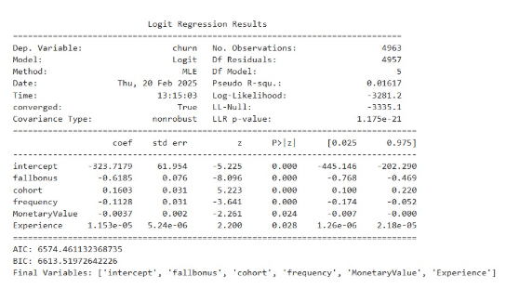



Churn Prediction Analysis on Social Raiders
SOCIAL RAIDERS
Receiving a fall bonus lowers churn risk, confirming the value of seasonal promotions
New players churn at a higher rate than older players, highlighting the importance of strong early engagement and retention strategies.

Slide 15
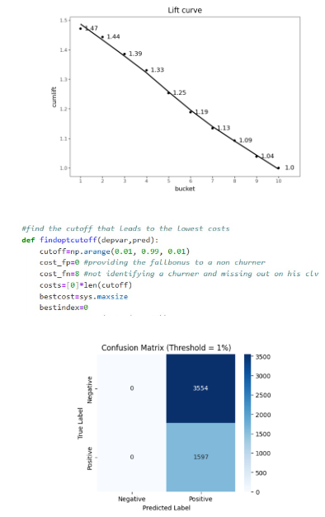


Fall Bonus Analysis
FOCUS ON SPECIFIC CUSTOMER
The model does a great job of finding customers most likely to leave, especially in the highest-risk groups. Its accuracy drops in lower-risk groups, showing that focusing on the highest-risk customers is the best way to improve retention.
GIVE THE BONUS TO EVERYONE
The cost of giving the Fall Bonus to a non-churner is set to zero, as it is a virtual product with no significant expense. This allows us to treat every paying customer as a potential churner for optimal marketing strategy.

Slide 16





Expand Fall Bonus
Offer the fall bonus to all players instead of limiting it.
Boosts engagement for both casual and competitive players.
Winter Returnee Event
Introduce a referral-based event for inactive or new players.
Active players share referral codes and both receive rewards.
Enhance Social Engagement
Promote team-based challenges, raids, and community achievements.
Strengthens social interactions and encourages teamwork.
Reccommendations
Expected Outcome
Higher player retention and reactivation rates.
Stronger player communities and increased in-game purchases.

Slide 17
DATA DRIVEN INSIGHTS
THANK YOU!
Group 6

